Slide 1









Idea submission

Slide 2


Team details
Team Lead: Name: Shaistha Siraj
Contact: 9035282737
Email:shaistha.cs24@bmace.ac.in
Team Member 2: Name: Anu.N
Contact: 7411115244
Email: anun.cs24@bmsce.ac.in

Slide 3

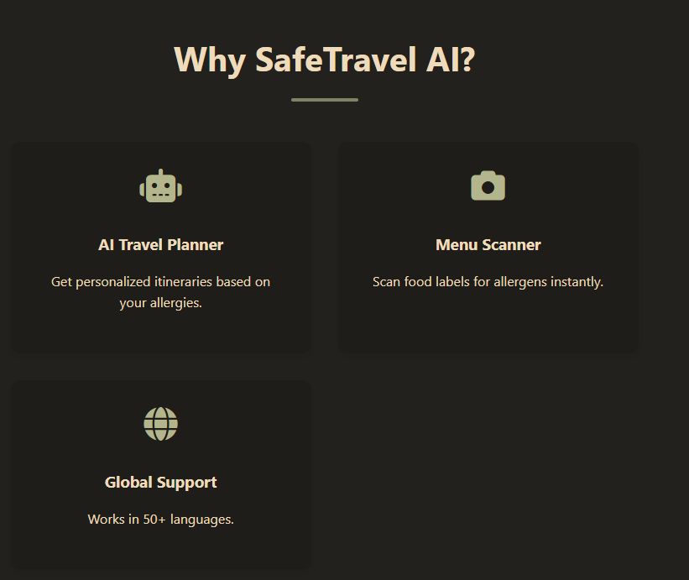
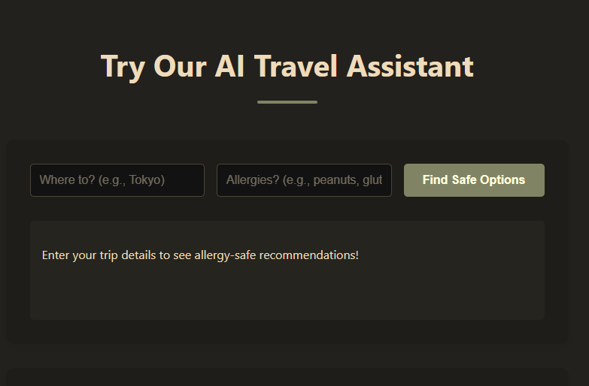

Our solution
Traveling with allergies can be stressful and even life-threatening. Many travelers struggle to find allergy-safe dining and lodging options, leading to limited choices, health risks, and a lack of confidence in their travel experiences.
“NomadGuard”– Your All-in-One Travel & Allergy Assistant Combines the best of both worlds: An AI-powered travel planner that also ensures allergy-safe dining. It scans global databases of restaurants, hotels, and food services, ensuring they meet specific allergen-free criteria.

Slide 4


TECHNICAL APPROACH
Technologies used in nomadguard AI
1.Artificial Intelligence & Machine Learning
Recommendation Engine: Uses AI to suggest allergy-safe restaurants and hotels based on user preferences.
Natural Language Processing (NLP): Scans restaurant menus, ingredient lists, and user reviews to detect allergens.
Computer Vision: Analyzes food labels and menus in real-time using image recognition to identify allergens.
2.Mobile & Web Technologies
Cross-Platform Mobile App (React Native / Flutter): Ensures compatibility across iOS and Android.
Progressive Web App (PWA): Allows users to access SafeTravel AI via web browsers without installation.
3. APIs & Data Integration
Food & Nutrition Databases: Pulls ingredient and allergen data from verified sources.

Slide 5
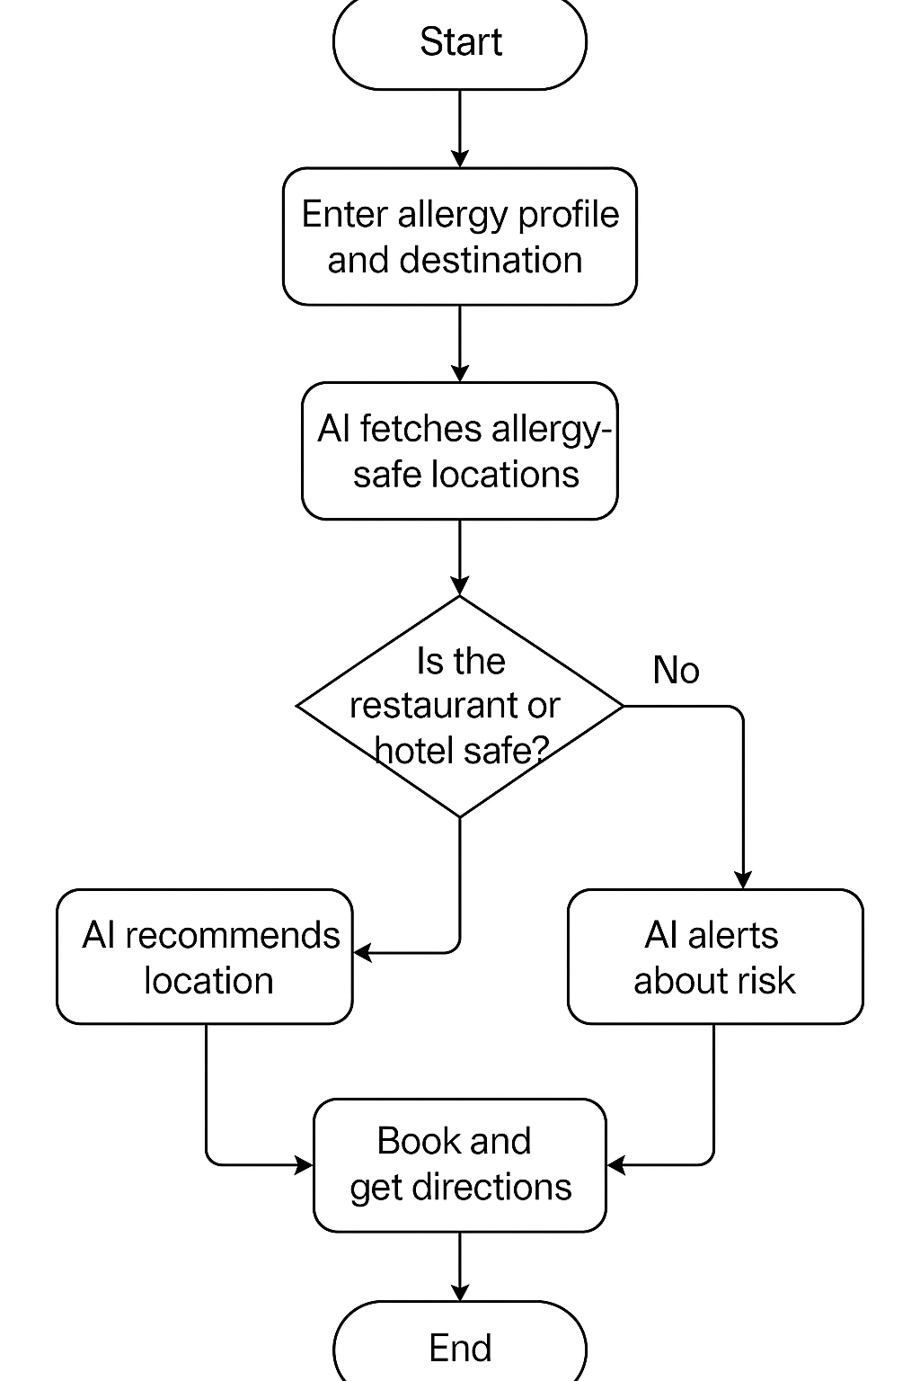
Workflow/pipeline
Data Collection & Integration – Collect allergy-safe travel data from restaurants, hotels, and user reviews.
Data Processing & Feature Engineering – Clean, structure, and extract features like allergens, location, and user preferences.
Model Training & Optimization – Train AI models to recommend safe dining/lodging options using NLP, computer vision, and collaborative filtering.
Real-Time Monitoring & Prediction – Deploy AI models to provide live updates, recommendations, and alerts.
User Interaction Layer – Enable web/mobile app access with voice assistants and chatbot integration.
.

Slide 6
Feasibility & FUTURE SCOPE
✅ Enhanced Safety for Travelers: Provides reliable allergy-safe dining and lodging recommendations. ✅ AI-Driven Personalization: Offers tailored suggestions based on individual allergy profiles. ✅ Seamless Integration: Works with existing travel platforms (Google Maps, Booking.com, etc.). ✅ Social Impact: Helps millions of allergy-sensitive travelers lead stress-free journeys. ✅ Scalable & Cloud-Based: Can expand globally with real-time updates.
Future Scope:
🚀 Blockchain for Data Transparency: Secure and verifiable allergy-safe listings. 🚀 Real-Time Food Scanner: AI-powered image recognition to detect allergens in meals. 🚀 IoT & Wearable Integration: Smart devices alert users in case of allergen exposure. 🚀 Multilingual Support: Expanding to cover global travelers with language-based assistance. 🚀 Partnerships with Airlines & Hotels: Ensuring allergy-safe travel at all stages.

